Slide 1
Application Layer & Operator Interfaces
Kunal Shroff
Software Technical Lead
EIC Accelerator Controls Global Software, Networking & Computing PDR
June 15-17, 2026

Slide 2
About Me – Kunal Shroff
I am the Controls Software Technical Lead for the Electron-Ion Collider (EIC) at Brookhaven National Laboratory, where I lead the architecture and deployment strategy for controls software and operational services.
I have 17 years of experience developing control systems software for large scientific facilities and serve as the technical lead of the EPICS Phoebus Collaboration, an international effort developing next-generation tools and services for accelerator control systems.
Education
M.S. Electrical & Computer Engineering, Stony Brook University
Technical Focus
Controls Architecture
EPICS & Phoebus
Distributed Systems
DevOps, CI/CD, & Infrastructure Automation

Slide 3
Charge Questions
Are the system requirements sufficiently defined, understood, and documented for this phase of the design?
Do the designs meet the requirements?
Are the interfaces sufficiently defined, understood and documented for this phase of the design?
Are the design analysis, simulations, drawings and specifications, and work plans, sufficient for this phase of the design?
Have technical risks been identified and are mitigation plans adequate for this phase of the design?
Are plans to address ES&H and Quality sufficient for this phase of the design?
Is the overall design maturity sufficient to proceed with the final design phase?

Slide 4
Outline
Scope
Requirements
Phoebus
Phoebus applications
Display Builder
Databrowser
Alarm Applications
Logging
Phoebus Architecture
Risks
Path Forward
Summary

Slide 5
Scope
Charge #1
User-facing tools for control system operation
Focus on applications used to monitor, operate, diagnose, and document large-scale control systems
Phoebus as the primary application environment
Cover the integrated Phoebus toolkit, including displays, alarms, archiving, logging, PV tools, and save/restore workflows
Client libraries beyond Phoebus
Include libraries that bring control system access into other environments and languages
Integration with analysis and engineering workflows
Discuss use from Python notebooks, MATLAB applications, scripts, and custom tools
Common goal
Provide flexible, connected interfaces for users to interact with the control system in the environment that best fits their task

Slide 6
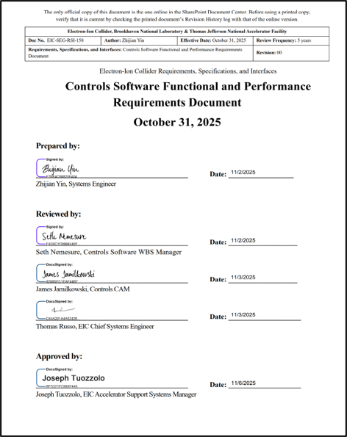
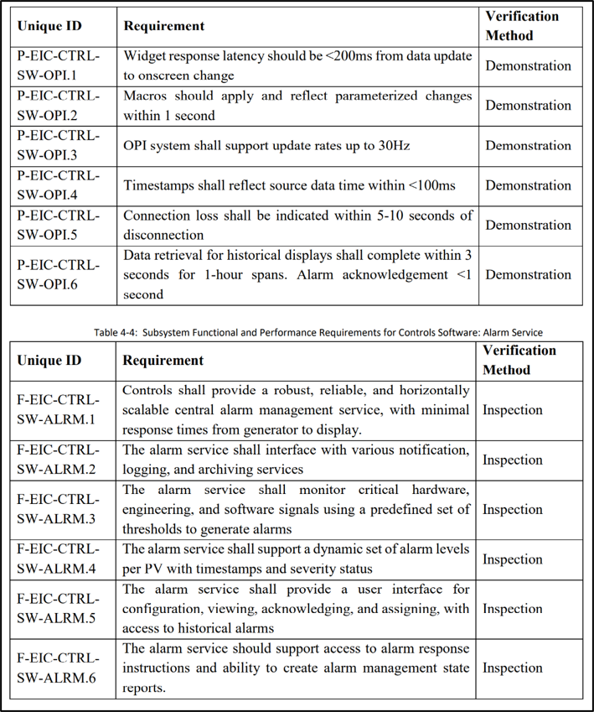
Requirements
Charge #1
Initial versions of the Performance Requirements Documents (PRDs)
High Level Applications [EIC-SEG-RSI-158]
Networking & Computing [EIC-SEG-RSI-XXX]

Slide 7
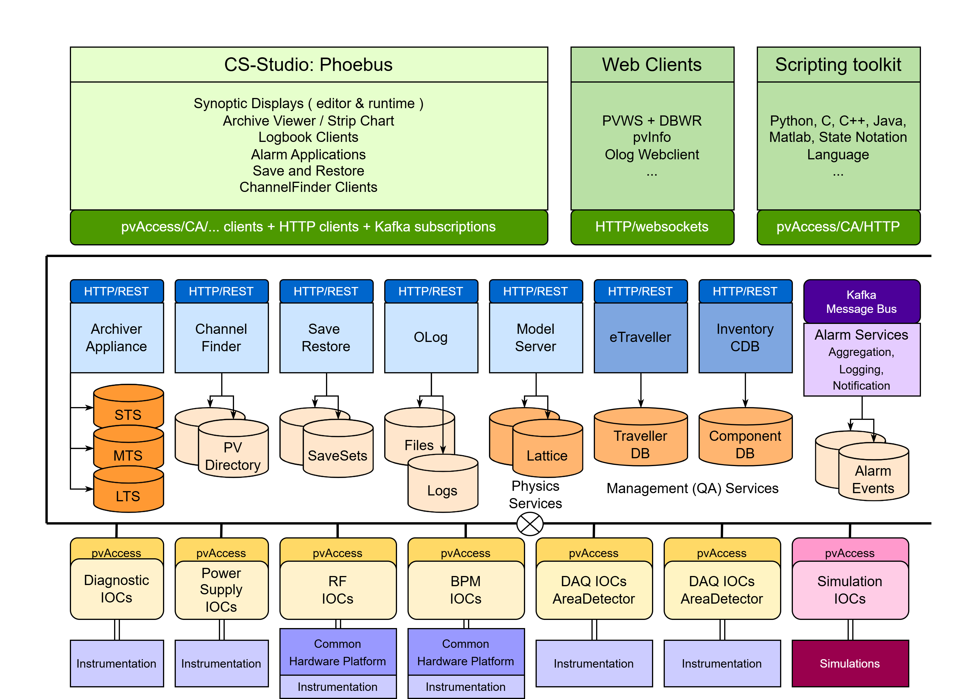
Control System Architecture
Charge #1-5
Operator and application layer (Phoebus tools, web tools, HLAs) [EIC-ROD-069]
Middle-layer services (Archiver, Alarm, Olog, ChannelFinder, Save/Restore, Gateway)
Control system layer (EPICS 7 with PVA-first, CA compatibility)

Slide 8
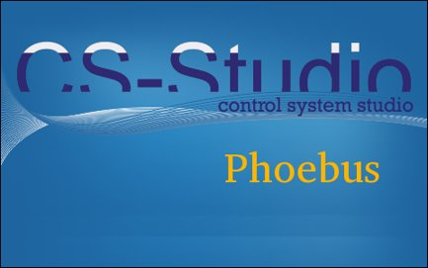
Phoebus
Charge #1-5
Rich client toolkit for control system applications
A collection of tools for monitoring, operating, and troubleshooting large-scale control systems
Provides a unified desktop environment for operators, engineers, and developers
Integrated application framework
Combines displays, alarms, archiving, logging, PV tools, and save/restore workflows
Enables applications to share data and operational context automatically
Seamless cross-application workflows
PV names, values, timestamps, alarm states, archive sources, displays, and logbook entries can move from one tool to another
Operators can move naturally from alarm investigation, to historical data, to device displays, to logbook documentation
Consistent and extensible user experience
Shared UI patterns, menus, selections, and context handling reduce operator effort
Applications interoperate through well-defined interfaces without tight coupling
Scalable, sustainable, and collaborative platform
Supports modern Java LTS releases, containerized deployment, CI/CD workflows, and microservice-based infrastructure
Developed collaboratively by facilities worldwide as an open ecosystem for control system tools

Slide 9
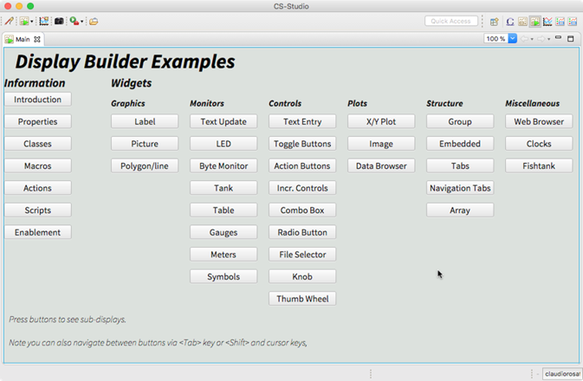
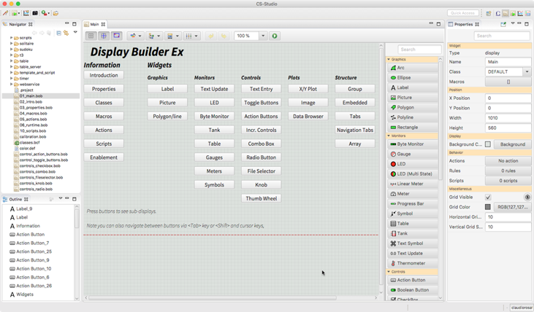
Display Builder
Charge #1,2,4
runtime
editor

Slide 10
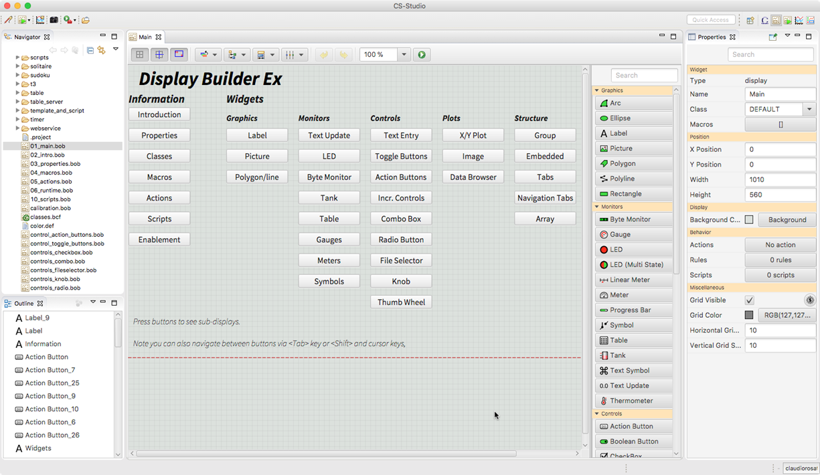
Display Builder - editor
Charge #1,2,4
WYSIWYG editor
Large Pallet of widgets
Control System Aware
Advanced customization through properties and scripting
Resuable widgets/groups/screens
Simple file format

Slide 11
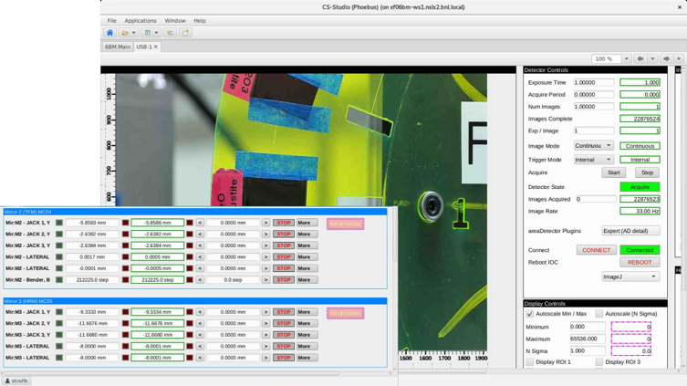
Display Builder - runtime
Charge #1,2,4
Live process data with metadata, alarm awareness, units, and precision

Slide 12
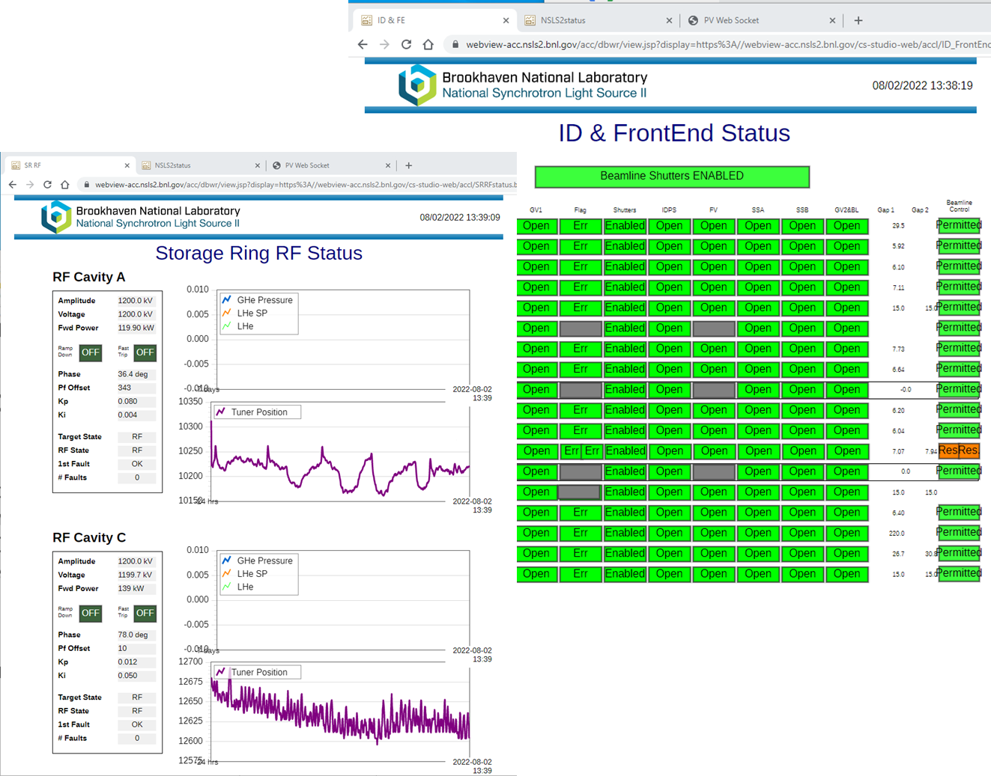
Web Runtime and Remote Operations
Charge #1,2,4
Help support remote operations by bringing OPI screens to the web
.bob files converted to web runtime OPI’s

Slide 13
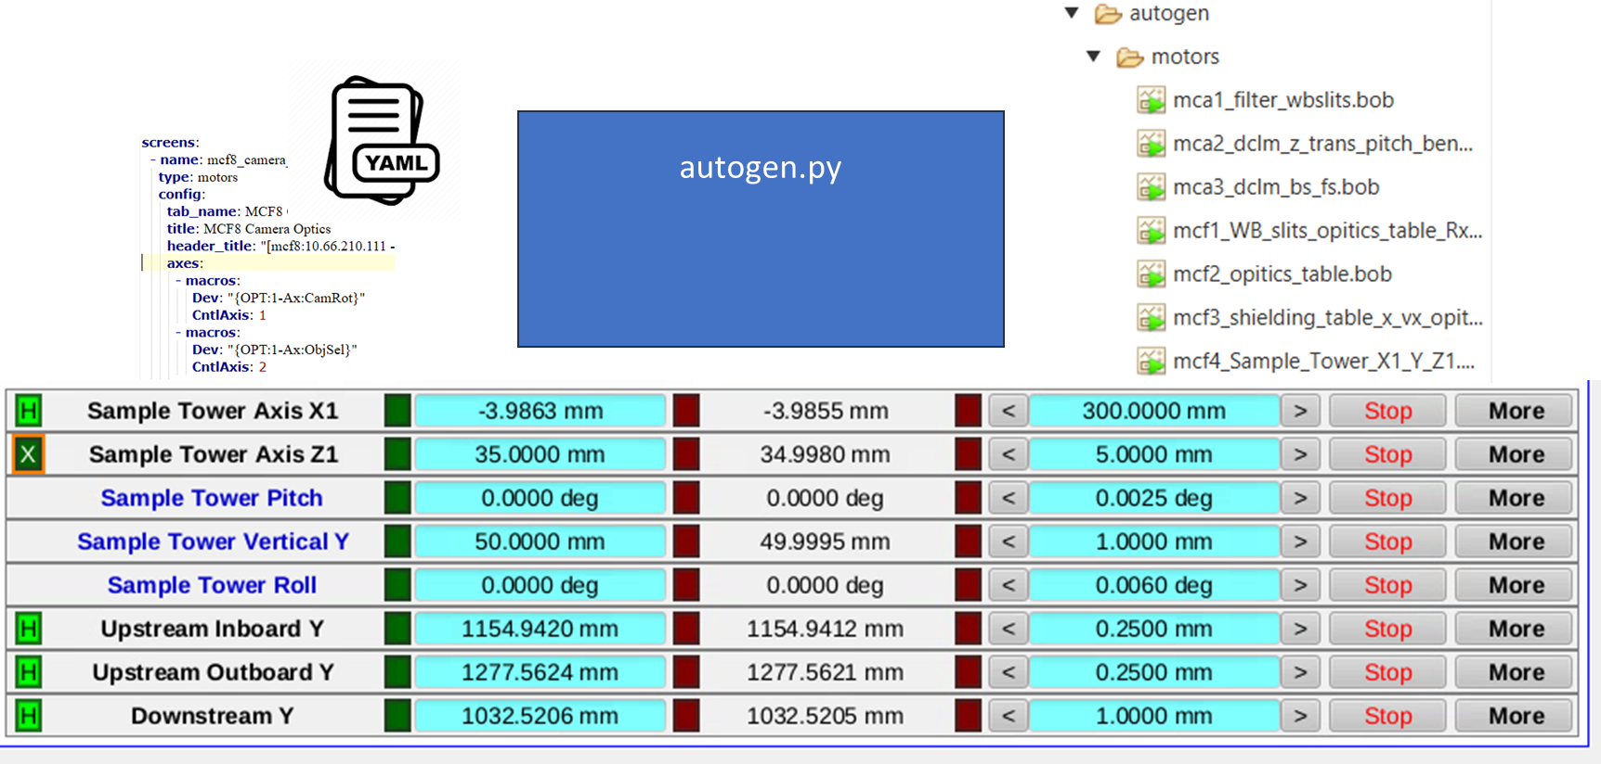
Screen creation
Charge #1,2,4

Slide 14
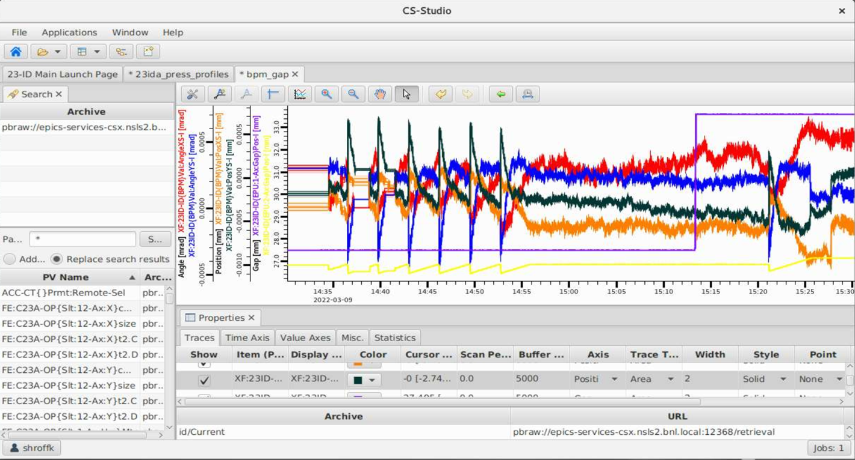
Data Browser
Charge #1,2,4
Presents live and historical data in one plotting environment
Cross-channel correlation for diagnosis and post-mortem analysis
Data export and inspection
Optimized retrieval
Workflow continuity with display, alarm, and logbook tools
Supports multiple archive providers

Slide 15
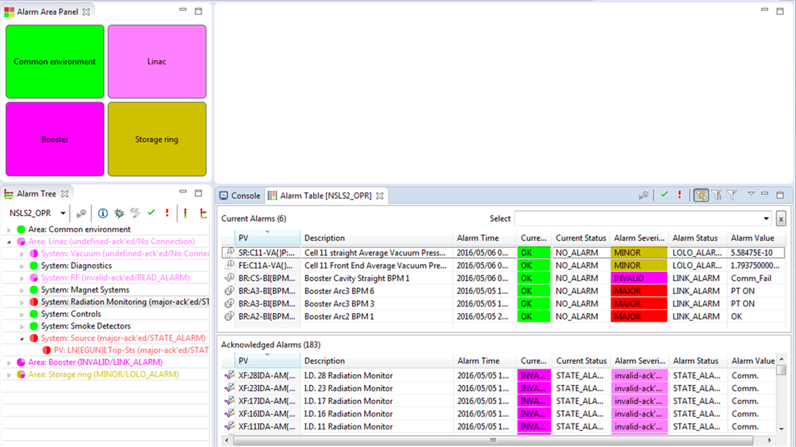
Alarm Applications
Charge #1,2,4
Goals
Support operator response quality and reduces troubleshooting latency during commissioning and operations
support configuration and management of Alarm Server behavior (alarm hierarchy, limits, and annunciation rules)

Slide 16
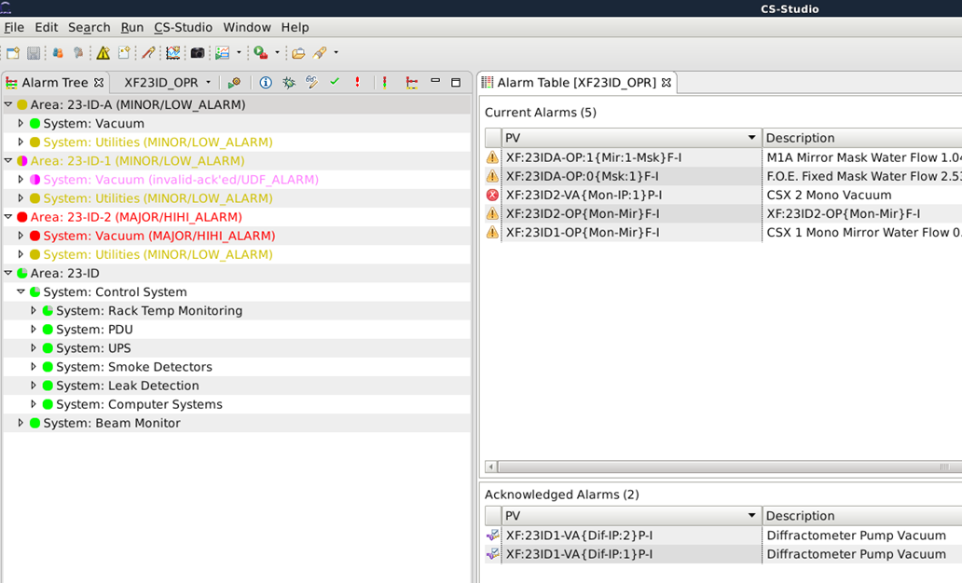
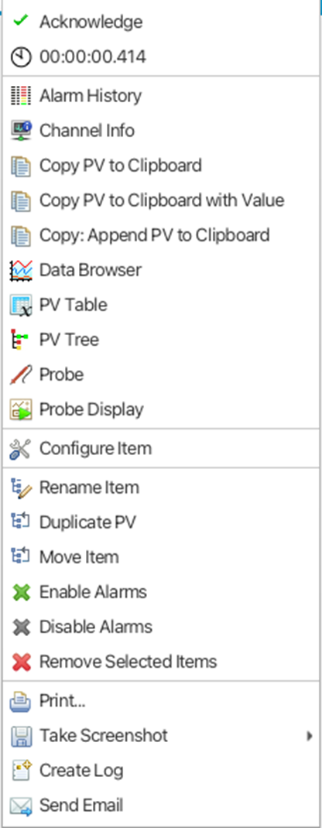
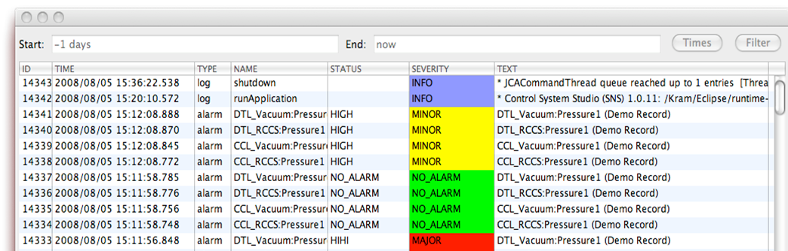
Alarm Applications
Charge #1,2,4
Alarm clients include
Tree
Organized hierarchical view of alarms
Table
Fast detection of new, pending, and acknowledged alarms with severity and timestamp context
Panel
Annunciator
Alarm history
supports post-mortem review and alarm-quality tuning

Slide 17
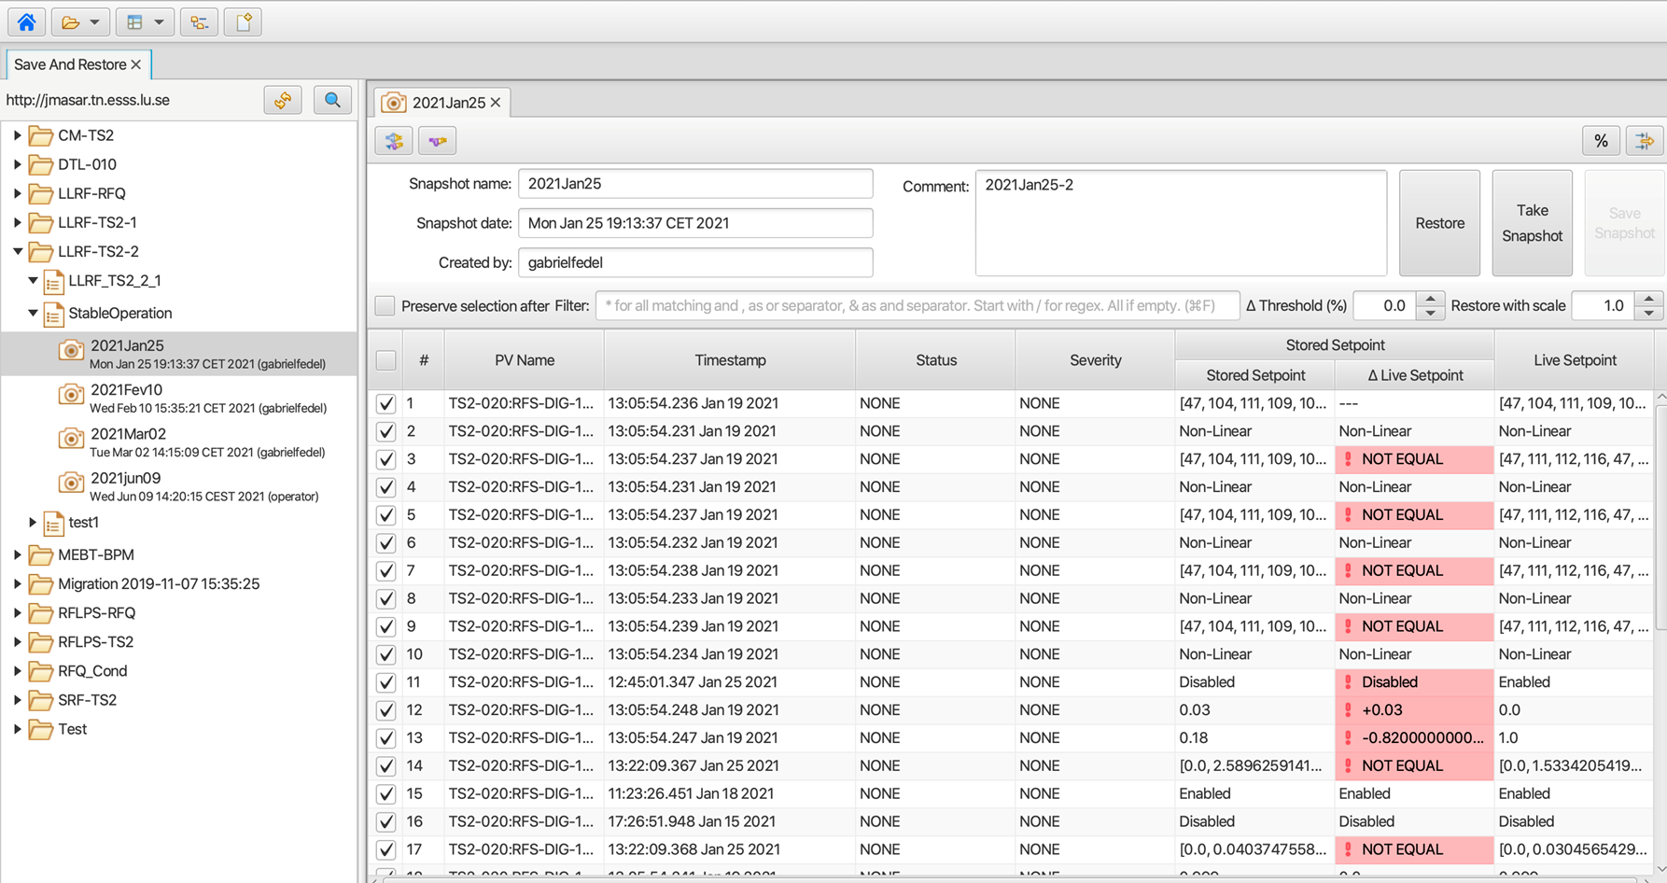
Save and Restore
Charge #1,2,4
Save & Restore
Organized representation of Configurations and Snapshots
Interface to live, archived, and snapshot data
Integration with logbook

Slide 18
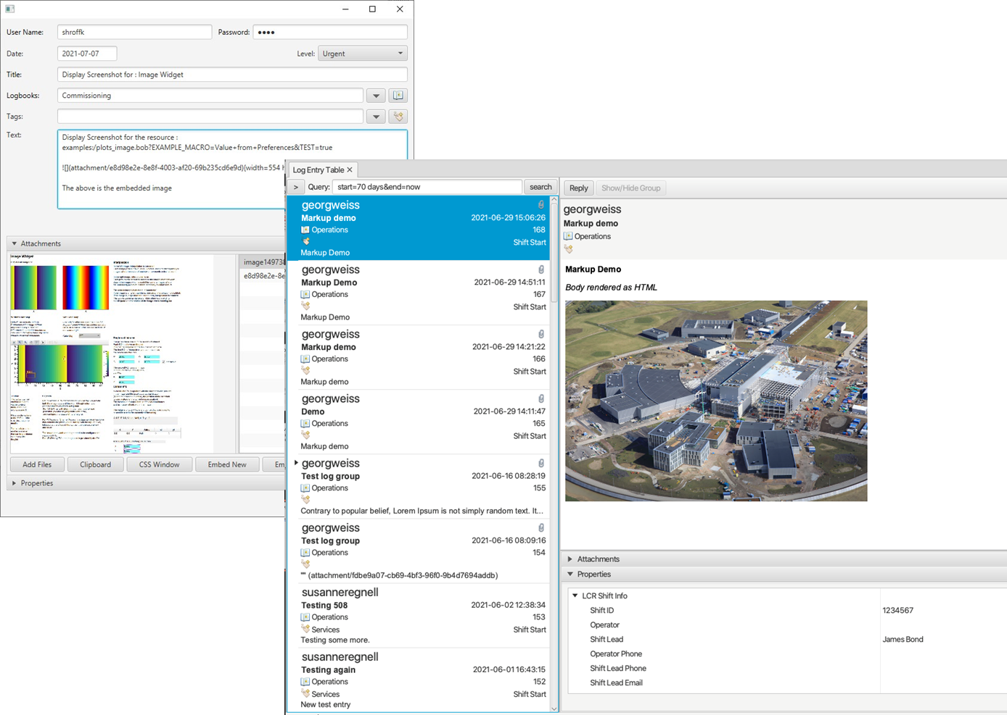
Logbook
Charge #1,2,4
Enable users to create and retrieve log entries which document EIC operations, observations, and events.
Phoebus clients Automatic context capture: Log entries are pre-populated from the active application state.
Web clients Easy access for quick entry and review
Notes:
Automatic context capture: Log entries are pre-populated from the active application state.
Alarm integration example: Entries created from Alarm tools can initialize with alarming PV(s), alarm severity/state, and timestamp.

Slide 19
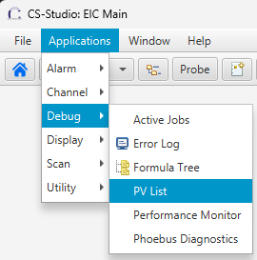
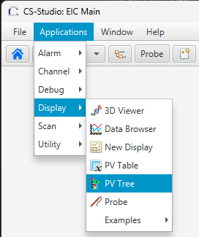
Applications Portfolio
Channel Finder Clients – fast PV search enriched with metadata (IOC host, record type, tags)
PV Utilities –
Probe: detailed PV introspection
PV Table: monitor/save groups of PVs
PV Tree: visualize EPICS record linkages

Slide 20
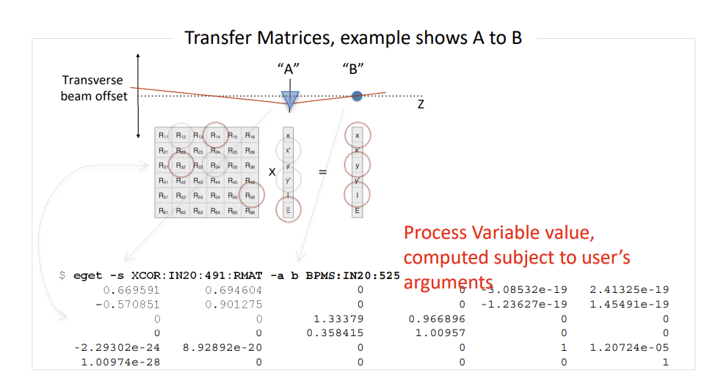
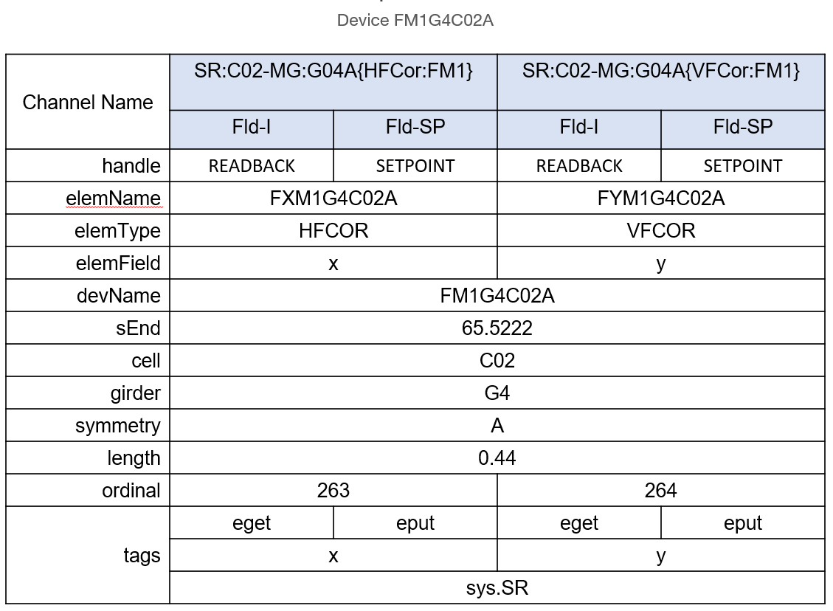
Commissioning tools
Tuning and Scans
Model-assisted scans, optimization loops, and scripted recovery/tuning workflows (HLA.1, HLA.2)
Beam Diagnostics and Optics Correction
Orbit, tune, trajectory, and optics correction using BPM and response-matrix methods
Model-Based Commissioning
Online model integration (virtual accelerator / digital twin style) to reduce machine time and risk (HLA.4)
Commissioning tools infrastructure
Infrastructure/framework needed to build and integrate these tools
Python and Java client libraries are in development for controls-system and middle-layer service access
Greg White, Murali Shankar SLAC; Ivo List, ESS
corrector = Corrector(deviceName=`FM1G4C02A`)
>> channels = cf.find(deviceName=‘FM1G4CO2A’)
xPos, yPos = corrector.getPositions()
>> xPosPv = cf.find([(deviceName,‘FM1G4CO2A’), (elemField, ‘x’)])
>> yPosPv = cf.find([(deviceName,‘FM1G4CO2A’), (elemField, ‘y’)])
>> caget(xPosPv ) and caget(yPosPv )
corrector.setPositions(xPos=1.23, yPos=3.21)
>> caput(‘SR:C02-MG:G04A{HFCor:FM1} Fld-SP’, 1.23)
>> caput(‘SR:C02-MG:G04A{VFCor:FM1} Fld-SP’, 3.21)
Notes:
- **Automated Tuning and Scans** - **Model-assisted scans and optimization loops automate iterative tuning while preserving operator oversight** - **Scripted commissioning workflows support repeatable setup, recovery, and retuning tasks** - **Aligns with HLA requirements for custom beam-physics applications and consistent packaging (F-EIC-CTRL-SW-HLA.1, HLA.2)** - **Beam Diagnostics and Optics Correction** - **Applications support orbit, tune, and trajectory correction using BPM data and response-matrix methods** - **Structured PV data and service interfaces enable machine-wide diagnostics and correction workflows** - **Supports faster fault isolation and reproducible correction studies during commissioning** - **RF and Timing Commissioning** - **Phase alignment, timing synchronization, and LLRF validation workflows are integrated with controls data paths** - **Injection timing and synchronization tools use repeatable scan/verify cycles with archived evidence** - **Interfaces are built on EPICS/PVA communication paths used by commissioning applications (F-EIC-CTRL-SW-HLA.3)** - **Configuration and State Control** - **Save/Restore snapshots capture known-good machine states for controlled studies and rollback** - **Versioned settings and repeatable restore workflows reduce risk during invasive tuning activities** - **Supports operational consistency across shifts and staged commissioning campaigns** - **Operational Traceability** - **Electronic logbook entries, alarm/event context, and archiver history provide auditable commissioning records** - **Post-mortem analysis correlates actions, alarm states, and time-series process data for root-cause studies** - **Improves handoff quality between operations, controls, and physics teams** - **Model-Based Commissioning** - **Online model integration (virtual-accelerator/digital-twin style) reduces machine time and commissioning risk** - **Model/control workflow supports comparison of measured behavior against predicted responses** - **Consistent with requirement to provide interfaces to physics modeling tools (F-EIC-CTRL-SW-HLA.4)** Notes: 1. This slide is intentionally physics-commissioning focused and excludes installation workflow tooling. 2. Keep each workflow tied to traceable evidence (logbook + alarms/events + archiver) to support review and post-mortem analysis. 3. All commissioning applications use EPICS/PVA interfaces and align with HLA requirements in EIC-SEG-RSI-158 Table 4-2. 4. Model-assisted commissioning is a risk-reduction strategy for limited machine-time phases. References: - HLA requirements authority: [supporting-docs/EIC-SEG-RSI-158-Control.Software-Performance.Requirements.Document.txt](../supporting-docs/EIC-SEG-RSI-158-Control.Software-Performance.Requirements.Document.txt) - EPICS software framework moves from controls to physics (paper): [presentations/raw/commissioning-tools/tuzzplm3.pdf](raw/commissioning-tools/tuzzplm3.pdf) - EPICS software framework moves from controls to physics (talk): [presentations/raw/commissioning-tools/tuzzplm3_talk.pdf](raw/commissioning-tools/tuzzplm3_talk.pdf) - High-level physics controls applications for FRIB (phantasy): [presentations/raw/commissioning-tools/tucpr07.pdf](raw/commissioning-tools/tucpr07.pdf) - EPICS decision baseline: [rod/EIC-ROD-EPICS-Control-System.md](../rod/EIC-ROD-EPICS-Control-System.md)

Slide 21
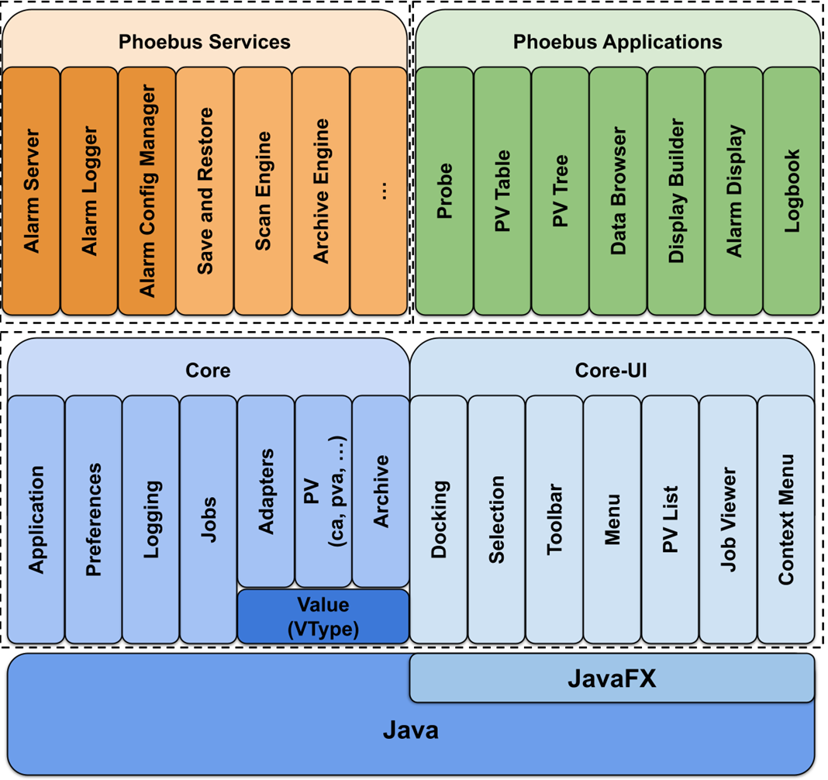
Phoebus Architecture
Charge #2,4,5
Modular framework 🡪 built on Java + JavaFX (no Eclipse RCP)
Core modules: PV access, VTypes, adapters, logging, jobs
Core-UI modules: docking, menus, selection services
Applications: operator-facing tools (Display Builder, Data Browser, etc.)
Jobs & scheduling – run tasks off the UI thread for responsiveness
Connection management – pooled, reusable PV and REST clients
VTypes – canonical value model
Protocol-agnostic, not tied to memory layout
Immutable and safe to share
Formula functions – efficient, thread-safe data processing pipelines
Notes:
•Jobs & scheduling – run tasks off the UI thread for responsiveness
•Connection management – pooled, reusable PV and REST clients
•VTypes – canonical value model
•Protocol-agnostic, not tied to memory layout
•Immutable and safe to share
•Formula functions – efficient, thread-safe data processing pipelines
•Selection services – share user-selected data cleanly across applications
•Adapter services – enable runtime integration between loosely coupled apps
•Preferences & layouts

Slide 22
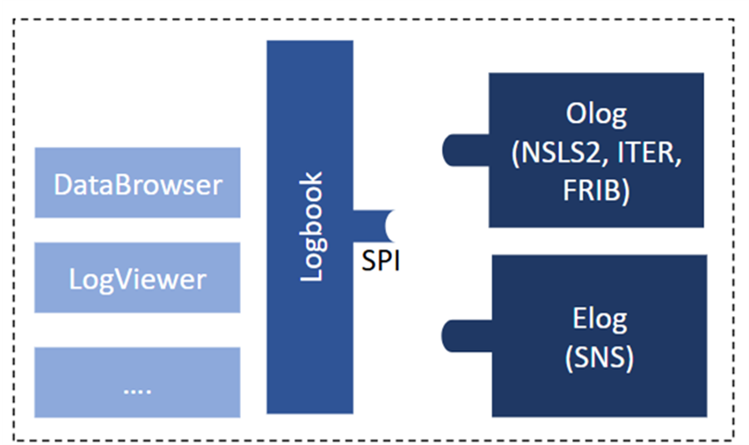
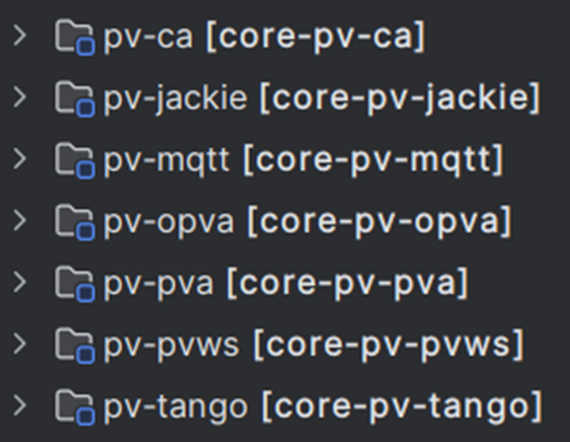
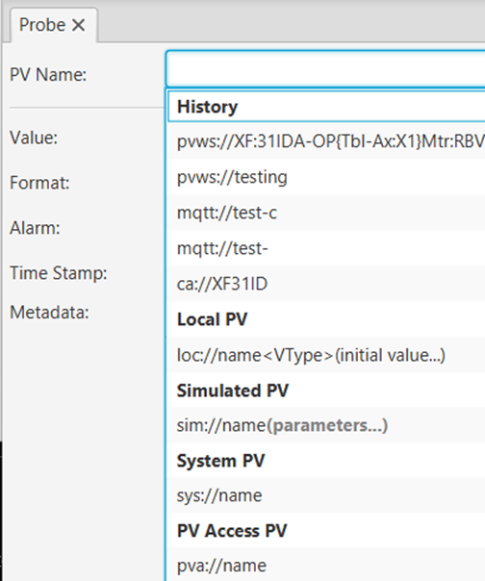
Phoebus Architecture - Extensibility
Charge #2,4,5
Charge #
Extensible via Java SPI (Service Provider Interface)
New data sources & protocols (CA, PVA, MQTT, Tango, …)
Clients for middle-layer services (Olog, elog, …)
New applications
UI extensions (menus, toolbars, context menus)

Slide 23
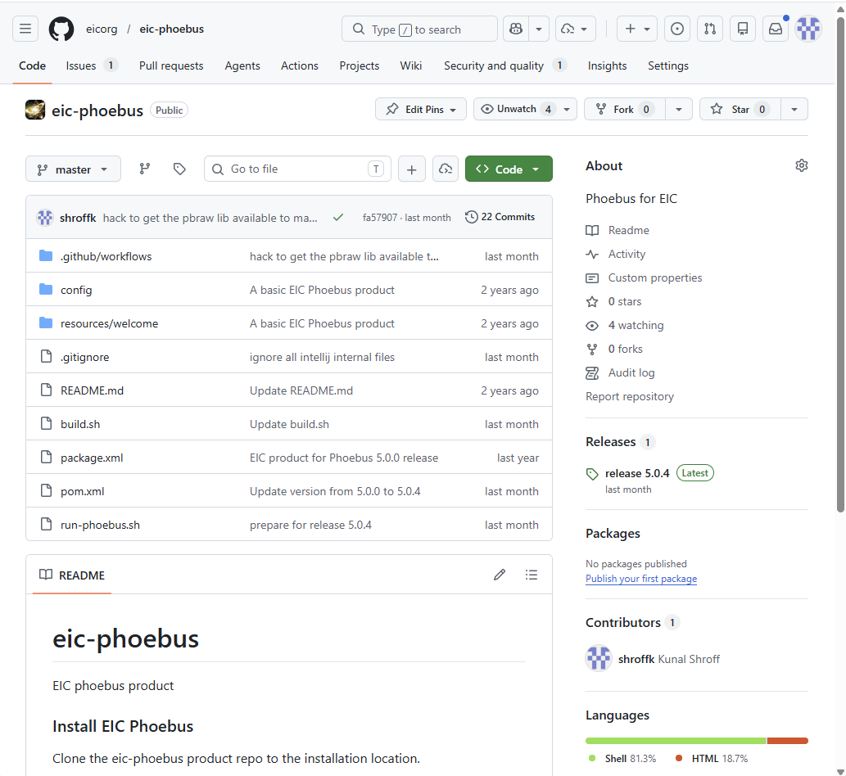
Phoebus Architecture – eic product
Charge #2,4,5
Charge #
EIC phoebus product includes site specific
Applications
Datasources
Configurations
Branding
Adapters
Address the needs of a particular organization or workflow.

Slide 24
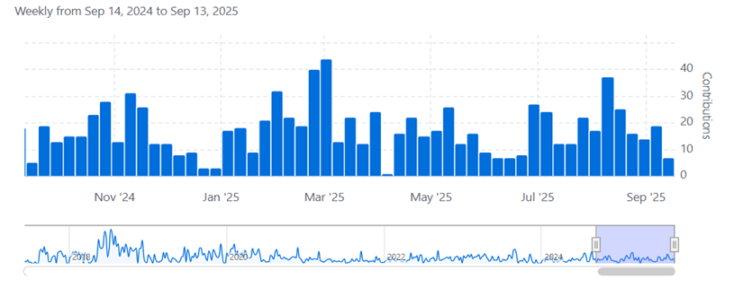
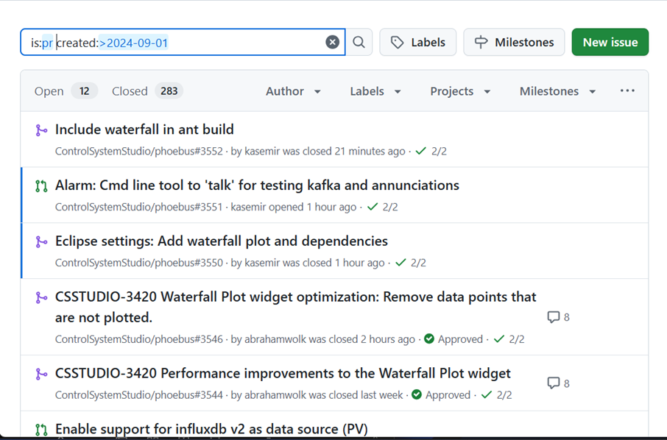
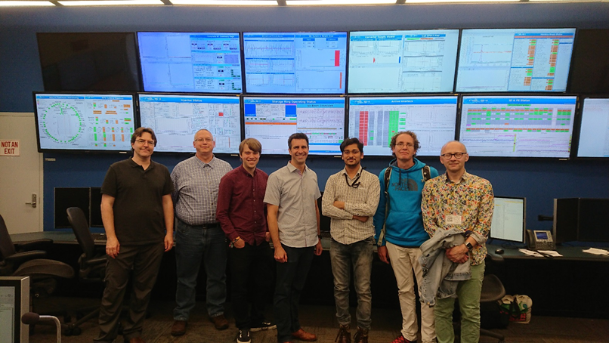
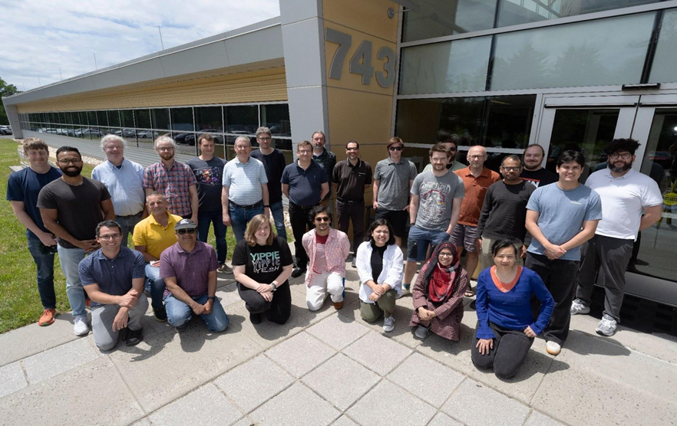
Phoebus Collaboration
Charge #2,5
Charge #
An international collaboration of dozens of research facilites
Phoebus
~300 PR’s
~100 Issue

Slide 25
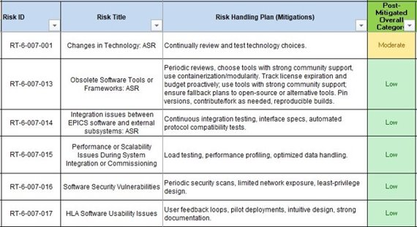
Risks
Charge #5
Risk RT-6-007-001
Mitigation: modular, extensible framework enables targeted upgrades with minimized disruption
Mitigation: multi-lab collaboration spreads maintenance risk and improves response speed to technology changes
Notes:
- **Application workflow model is coherent and source-backed**
- **Core application set, middle-layer service model, and architecture direction are defined**
- **Desktop and web usage patterns are established**
- **Complete formal performance characterization under representative load**
- **Finalize subsystem rollout priorities and acceptance evidence**
- **Close unresolved interface and operational ownership items**
- **Validate web-runtime and service assumptions against EIC-specific rollout plans**
- **Are boundaries of the application scope acceptable for this phase?**
- **Which workflows need deeper review before final design?**
- **Which source talk elements stay in the main body versus appendix for the final slide deck?**

Slide 26
Summary
Phoebus is the primary application environment for EIC operator workflows, with integrated tools for control, diagnostics, and documentation
Display Builder, Web Runtime, and Data Browser provide a practical path from screen creation to remote operations and post-event analysis
Alarm, Save/Restore, and Logbook workflows improve operational response quality, repeatability, and traceability
PV utilities strengthen day-to-day usability through fast discovery, metadata context, and diagnostics support
A modular Java/JavaFX architecture with SPI extensibility supports long-term maintainability and site-specific product composition
Active multi-lab collaboration and targeted risk mitigations position the applications stack for final-design progression

